Slide 1

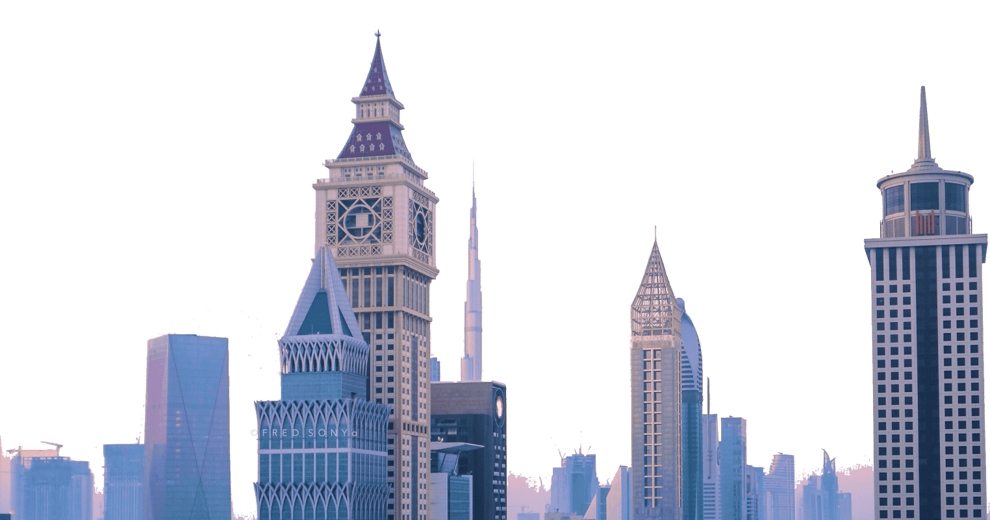
DUBAI
WHY WE SHOULD GO TO

Slide 2
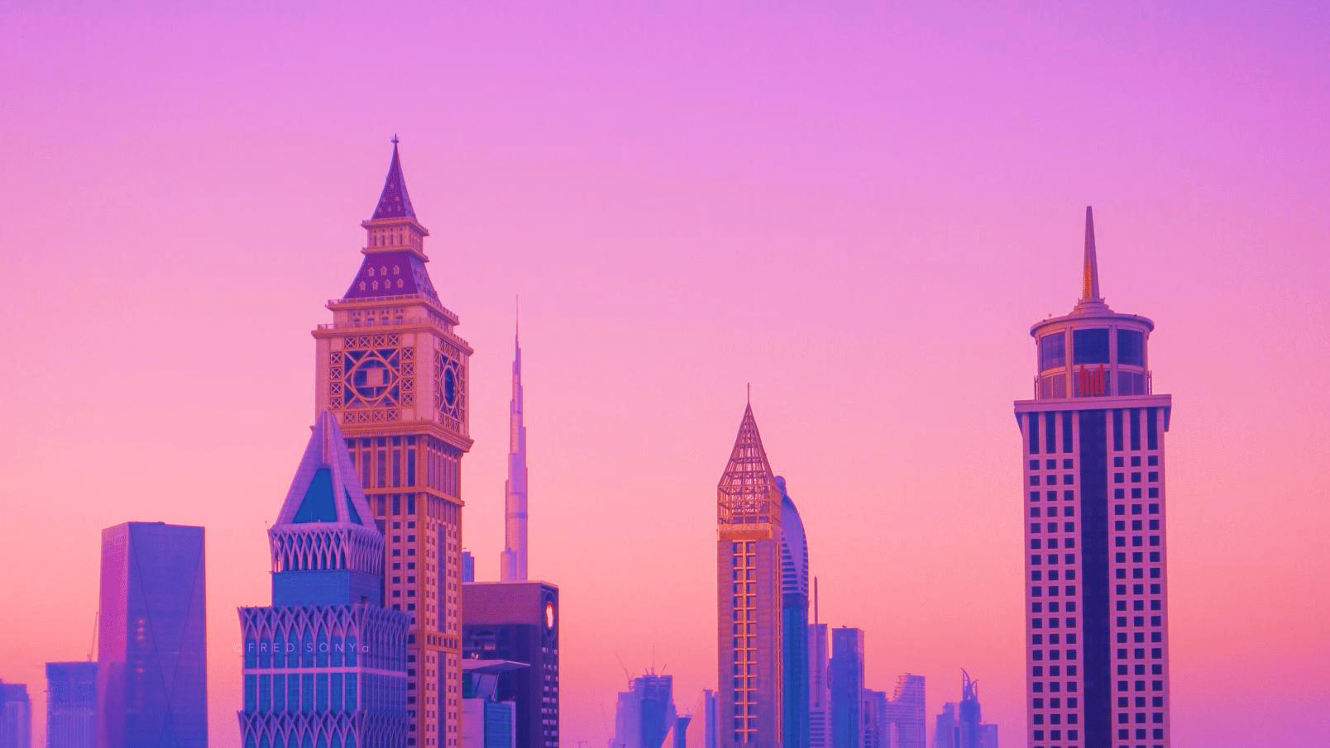
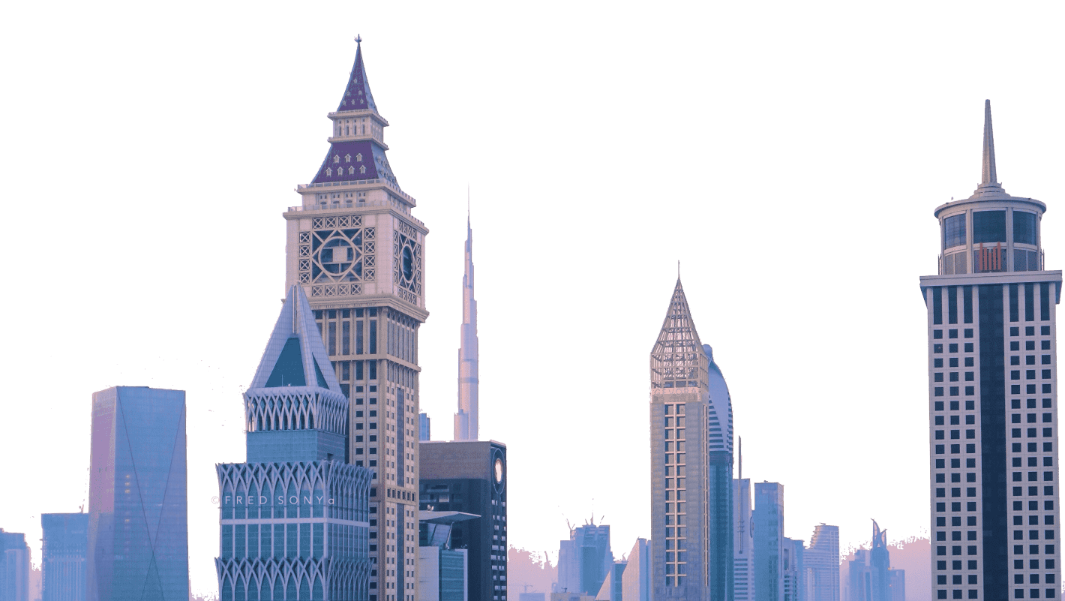
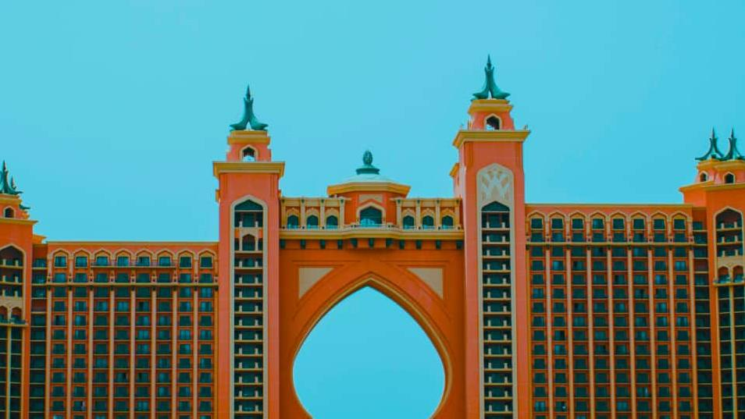
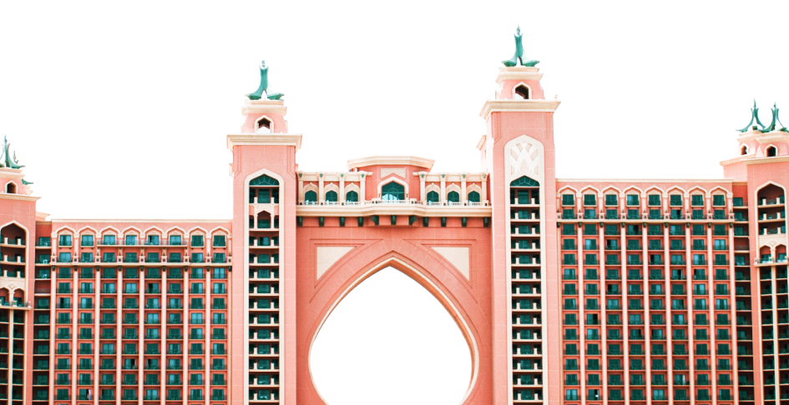
DUBAI
WHY WE SHOULD GO TO
ACCOMODATION

Slide 3
WHY WE SHOULD GO TO
DUBAI
ACCOMODATION
ATLANTIS

Slide 4
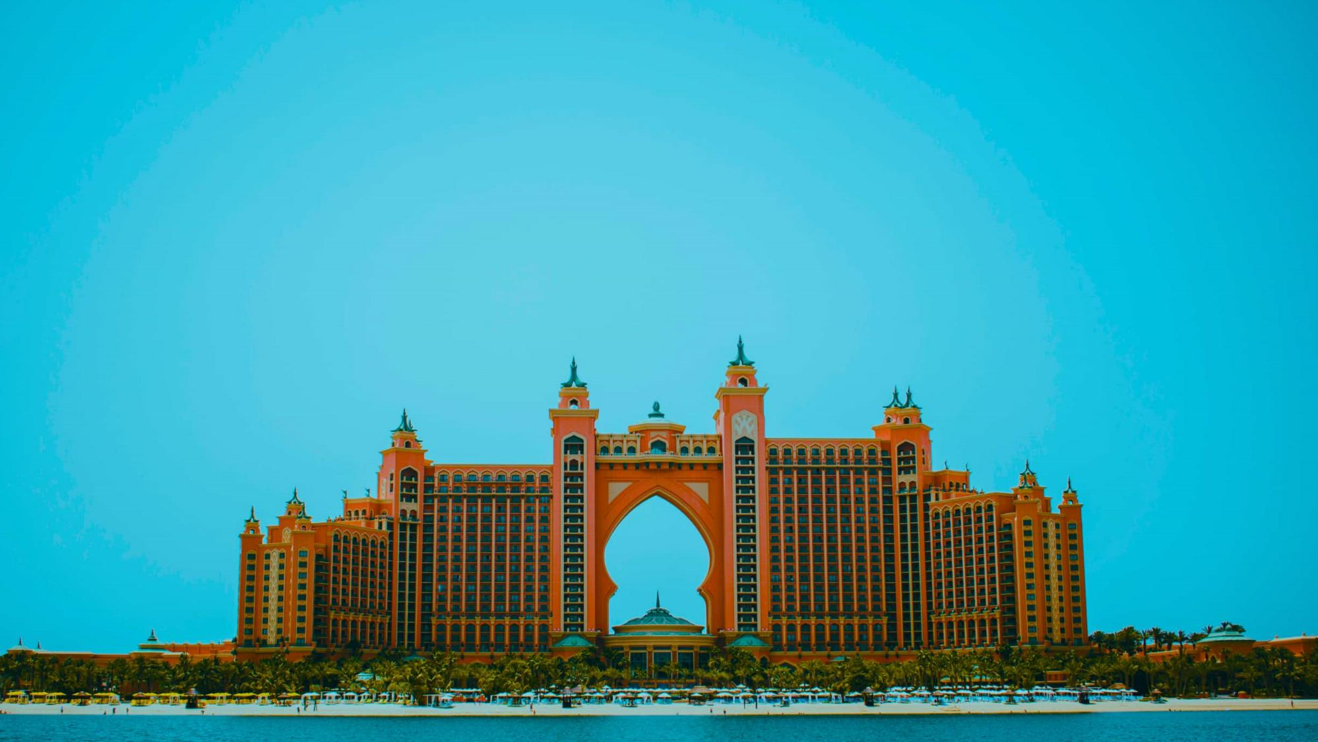
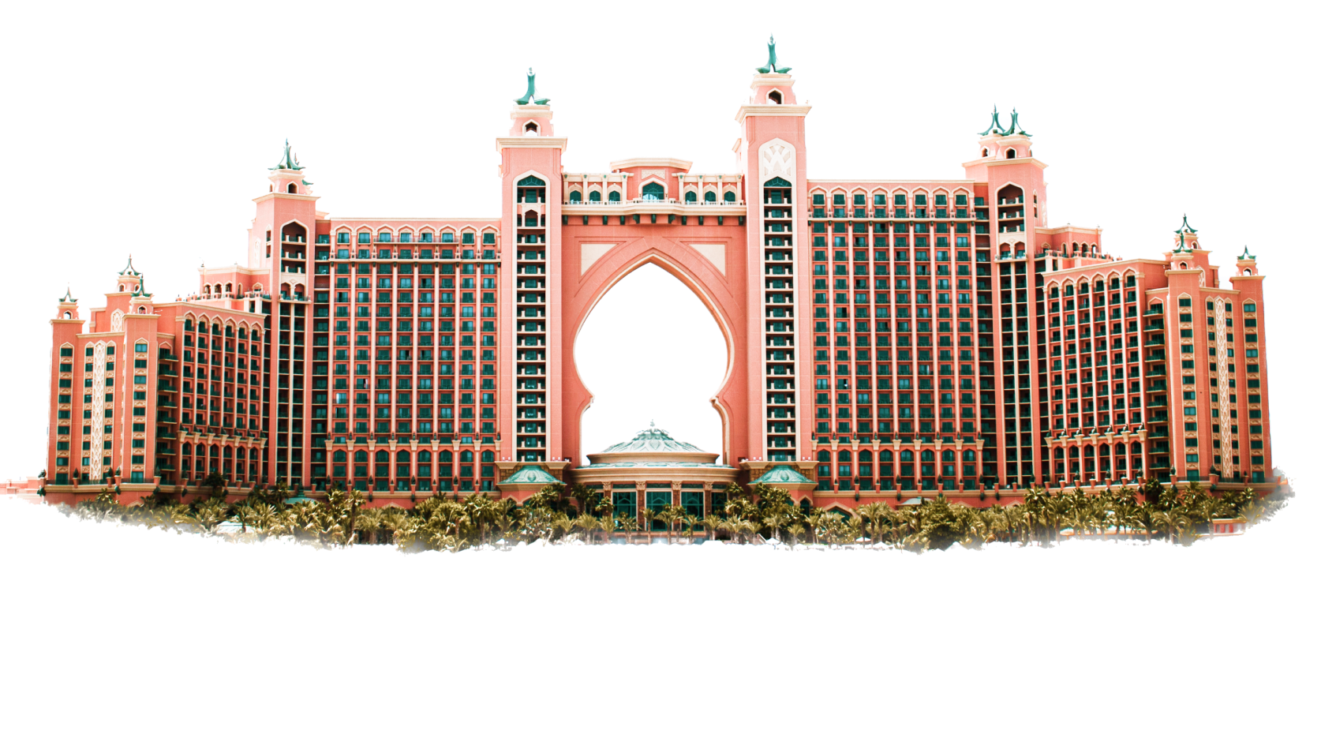
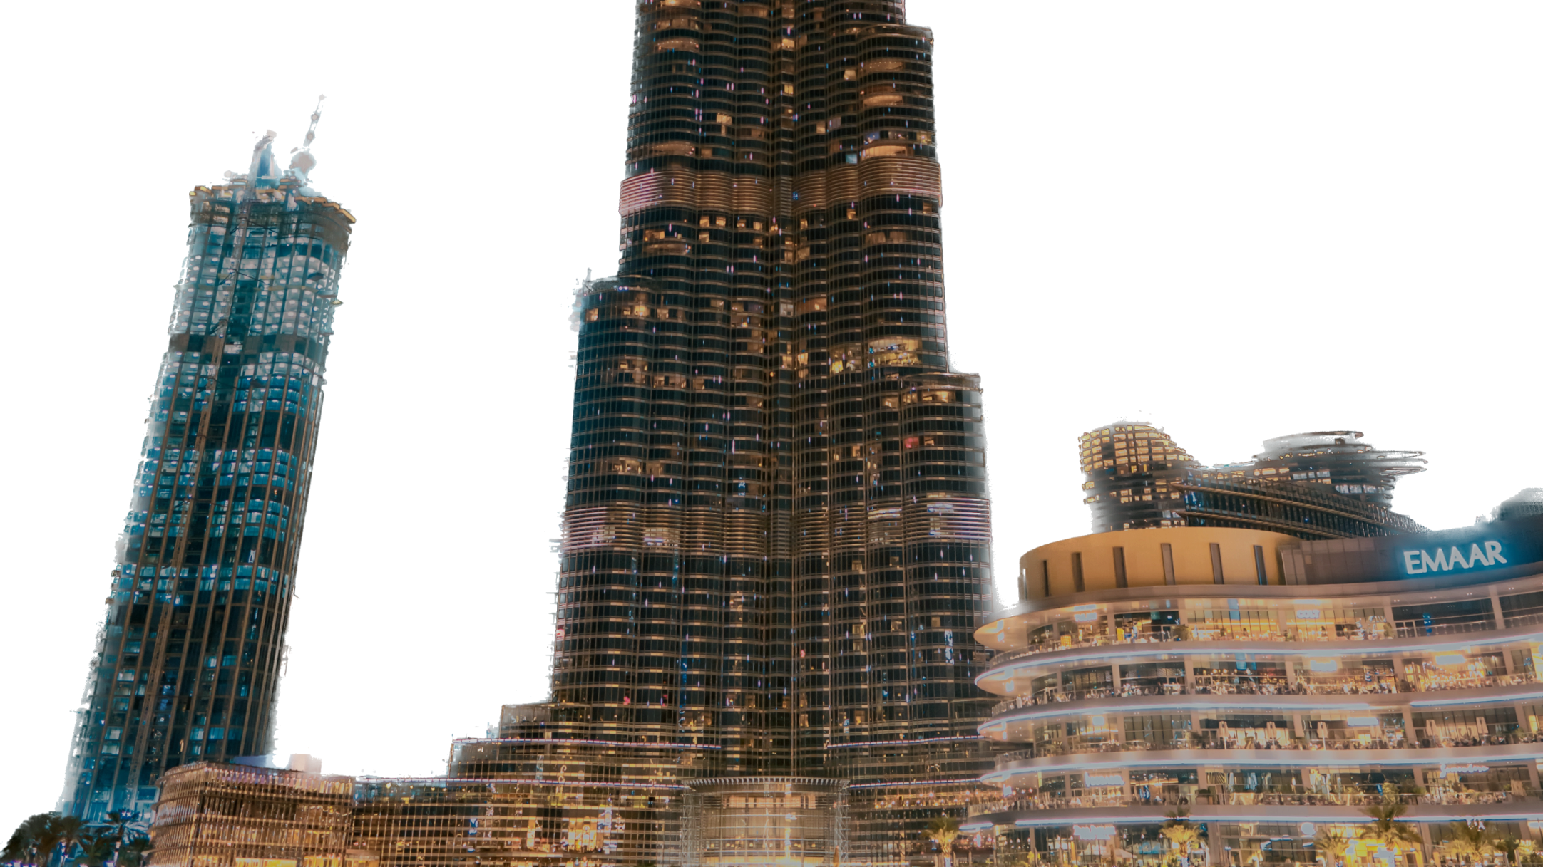
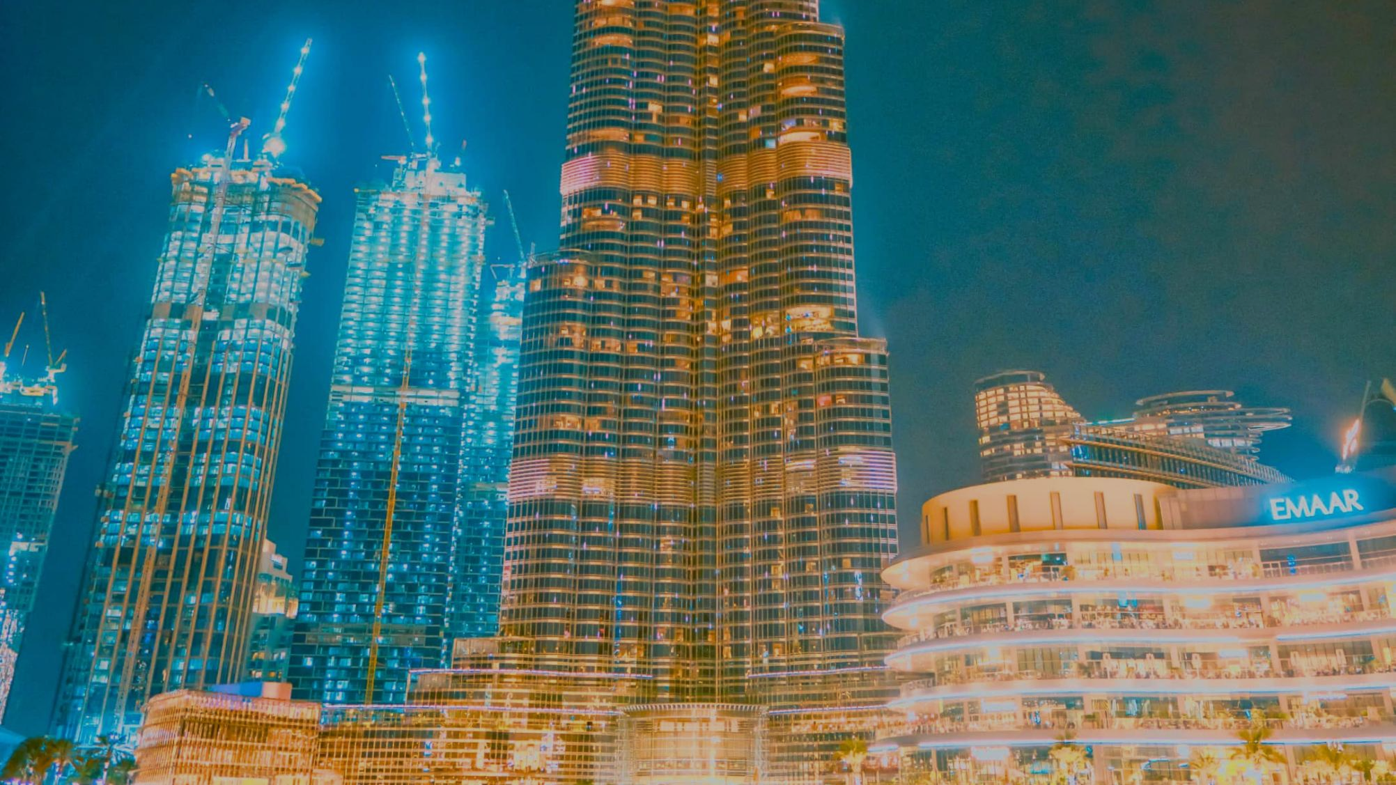
THE PALM
ACCOMODATION
ATLANTIS
WORLD’S TALLEST BUILDING

Slide 5
KHALIFA
ATLANTIS
THE PALM
WORLD’S TALLEST BUILDING
BURJ

Slide 6
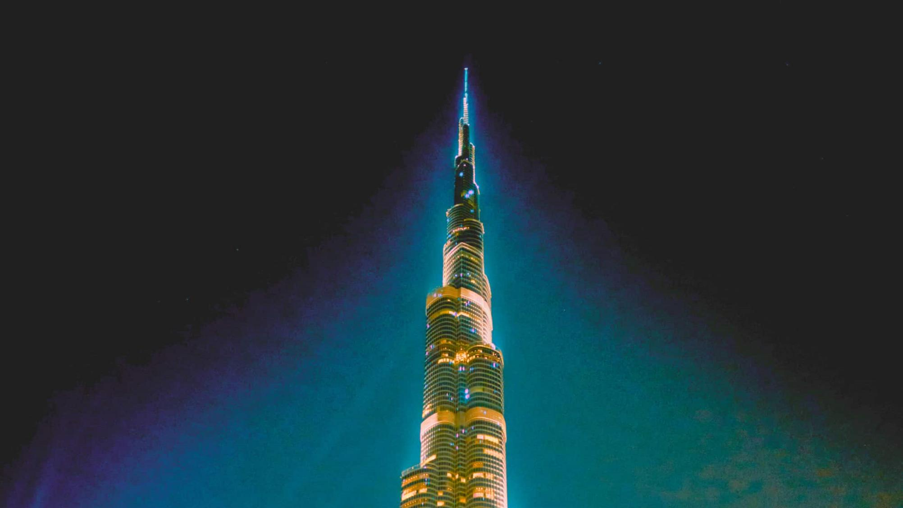
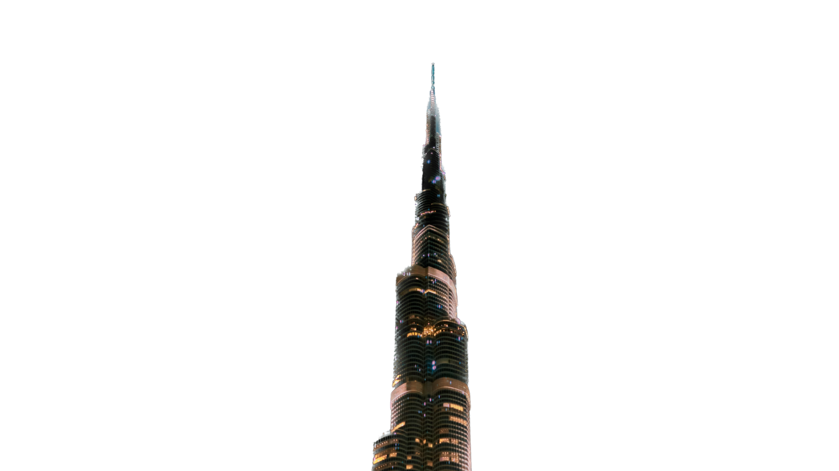
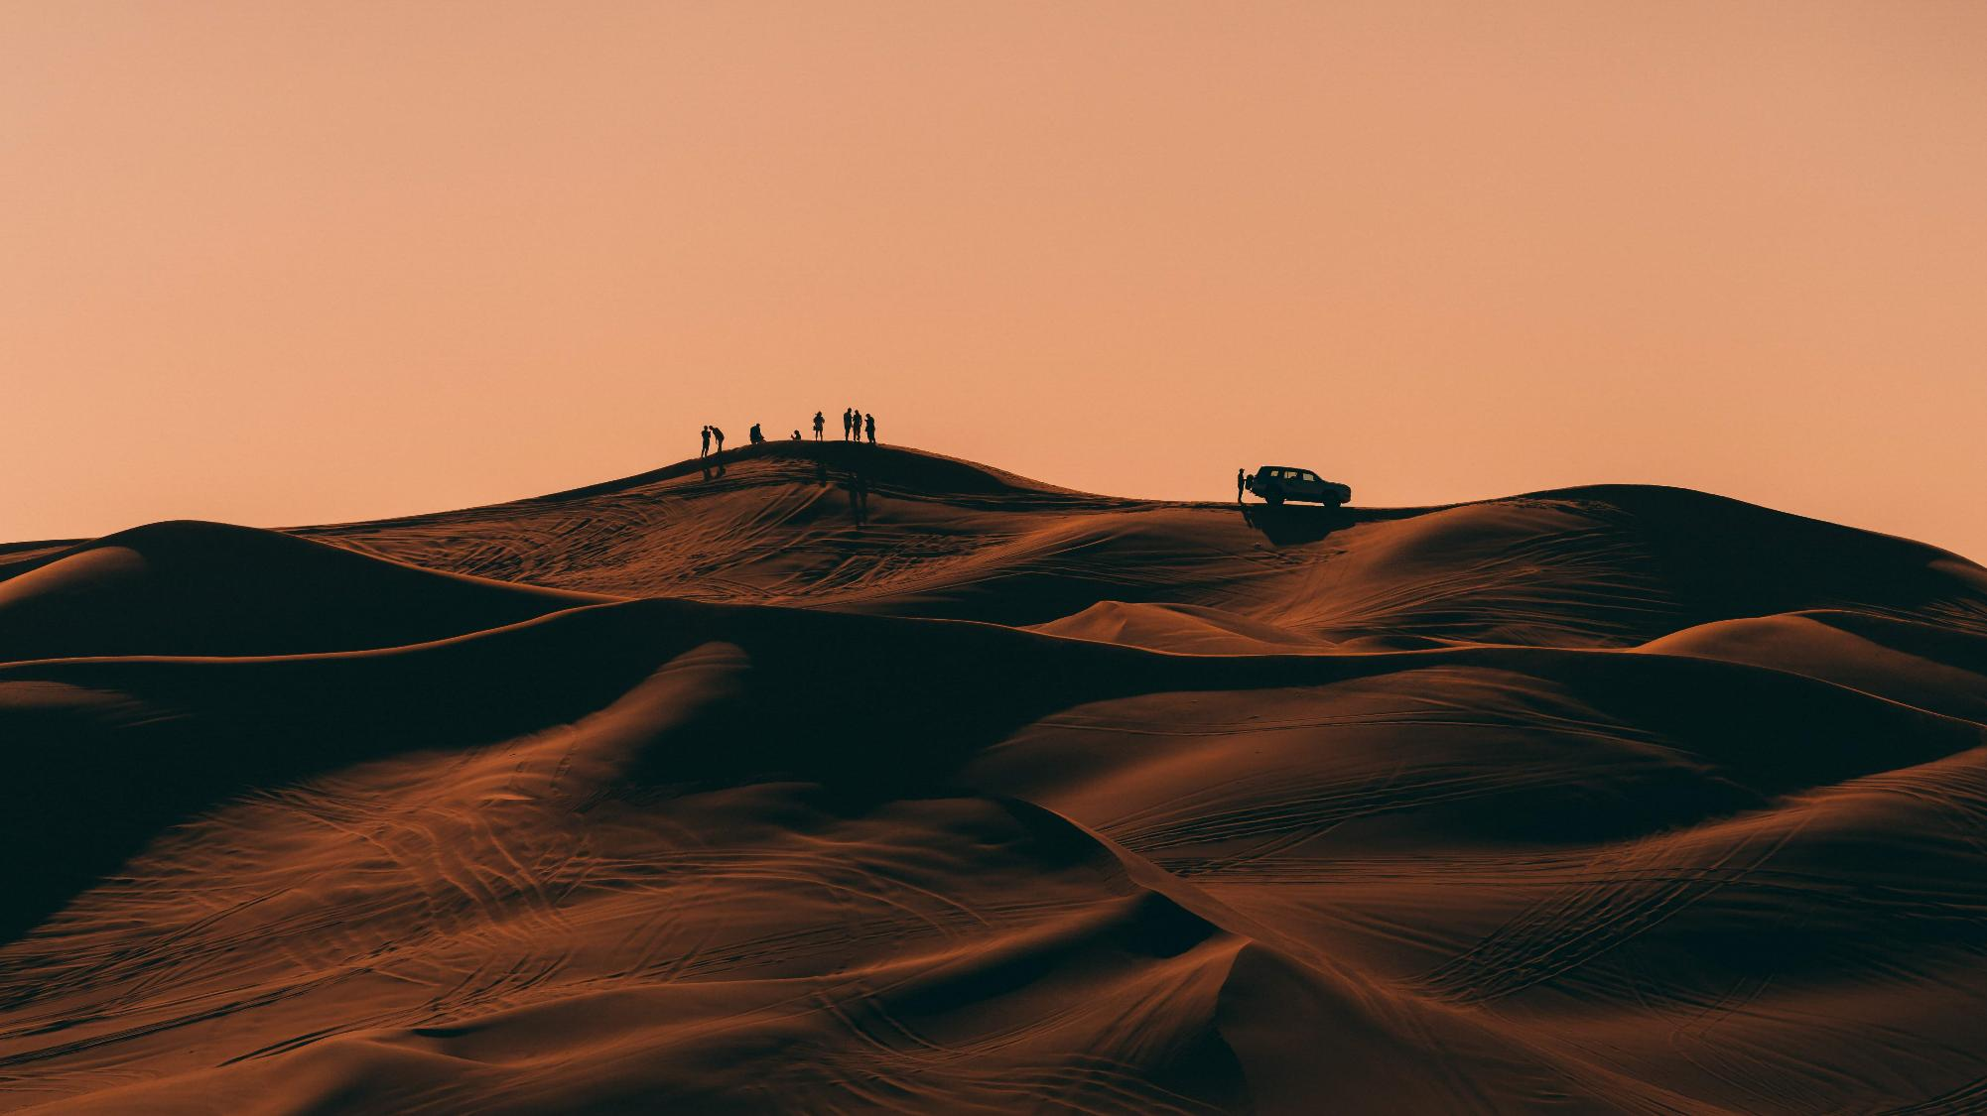
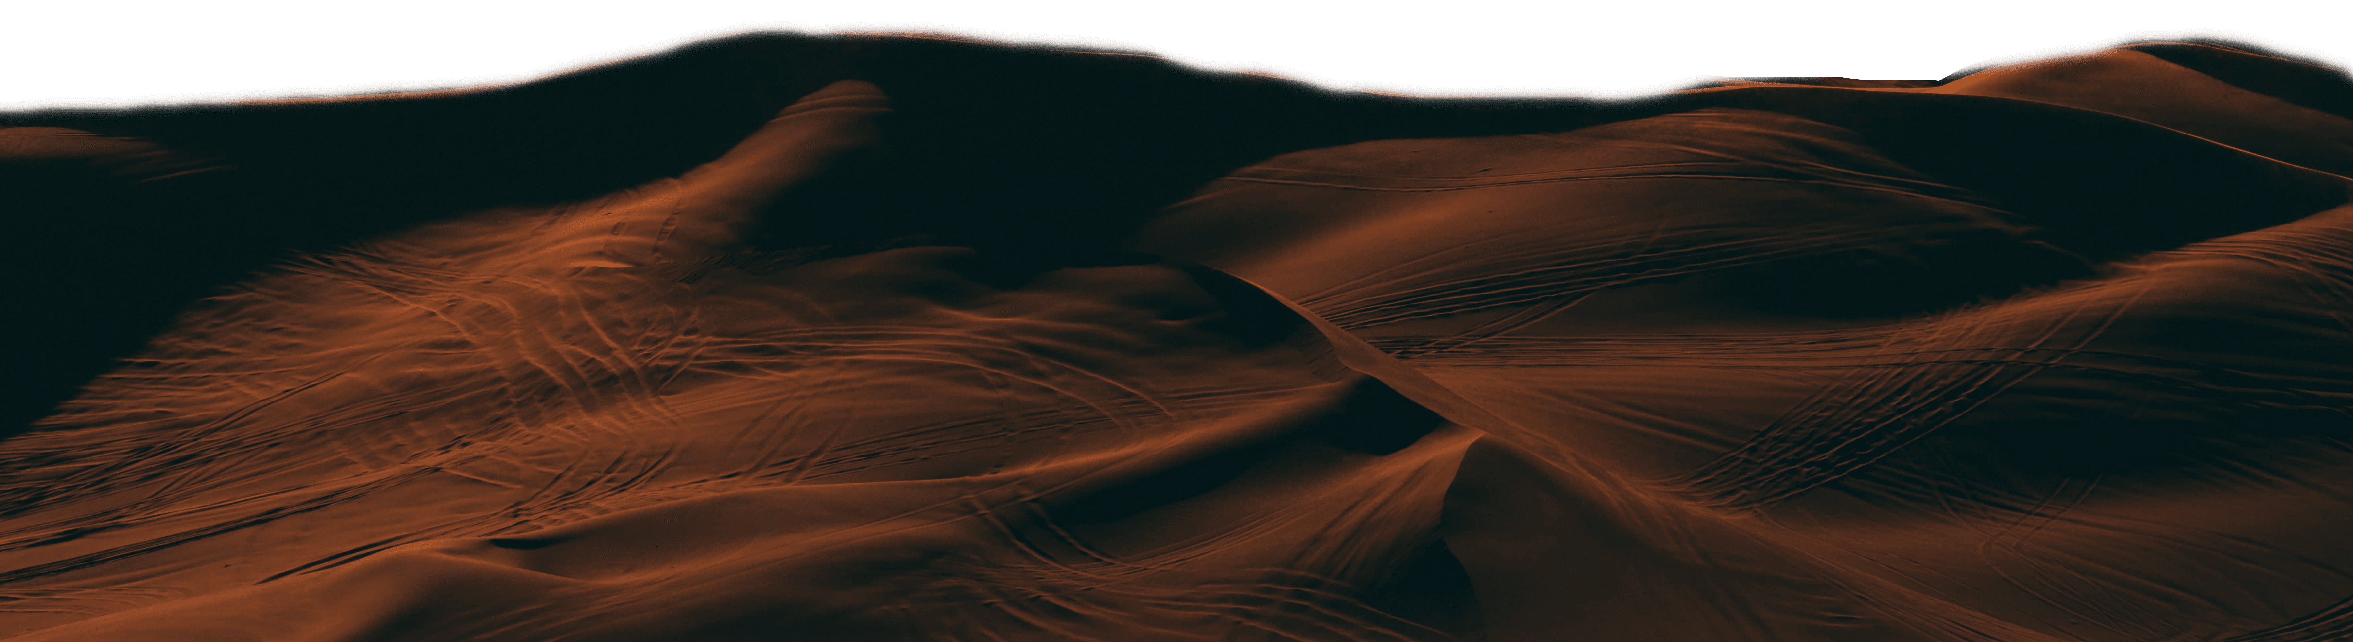
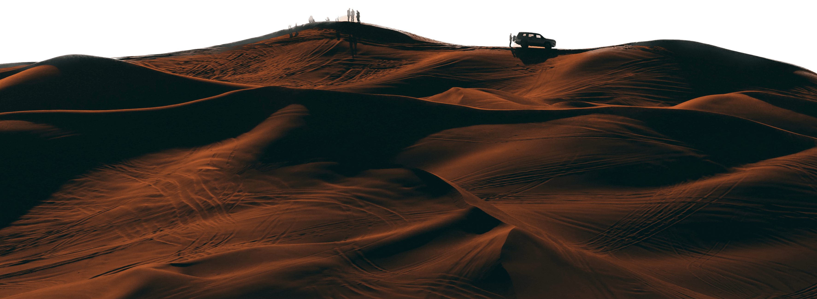
KHALIFA
WORLD’S TALLEST BUILDING
BURJ
SAFARI
CAMEL: RIDING | DUNE BASHING | HENNA PAINTING SUNSET VIEWS | SHISHA | BELLY DANCING SHOW

Slide 7
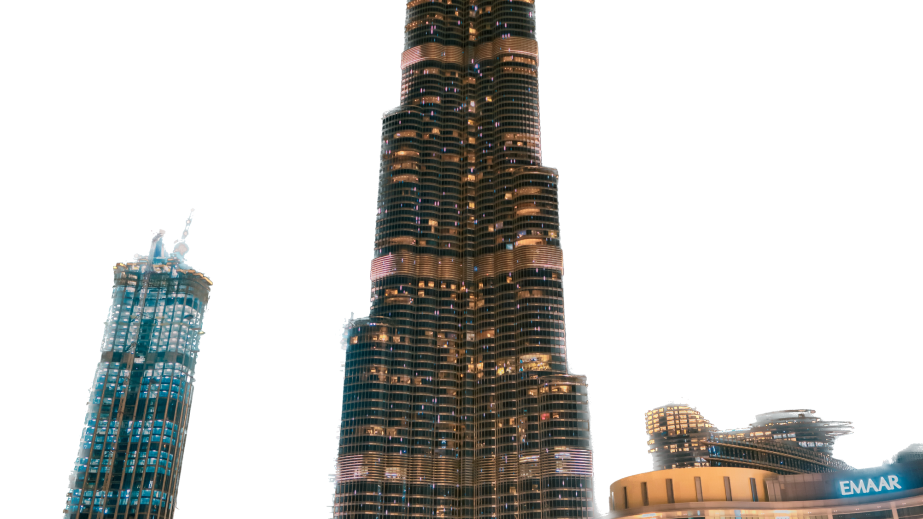
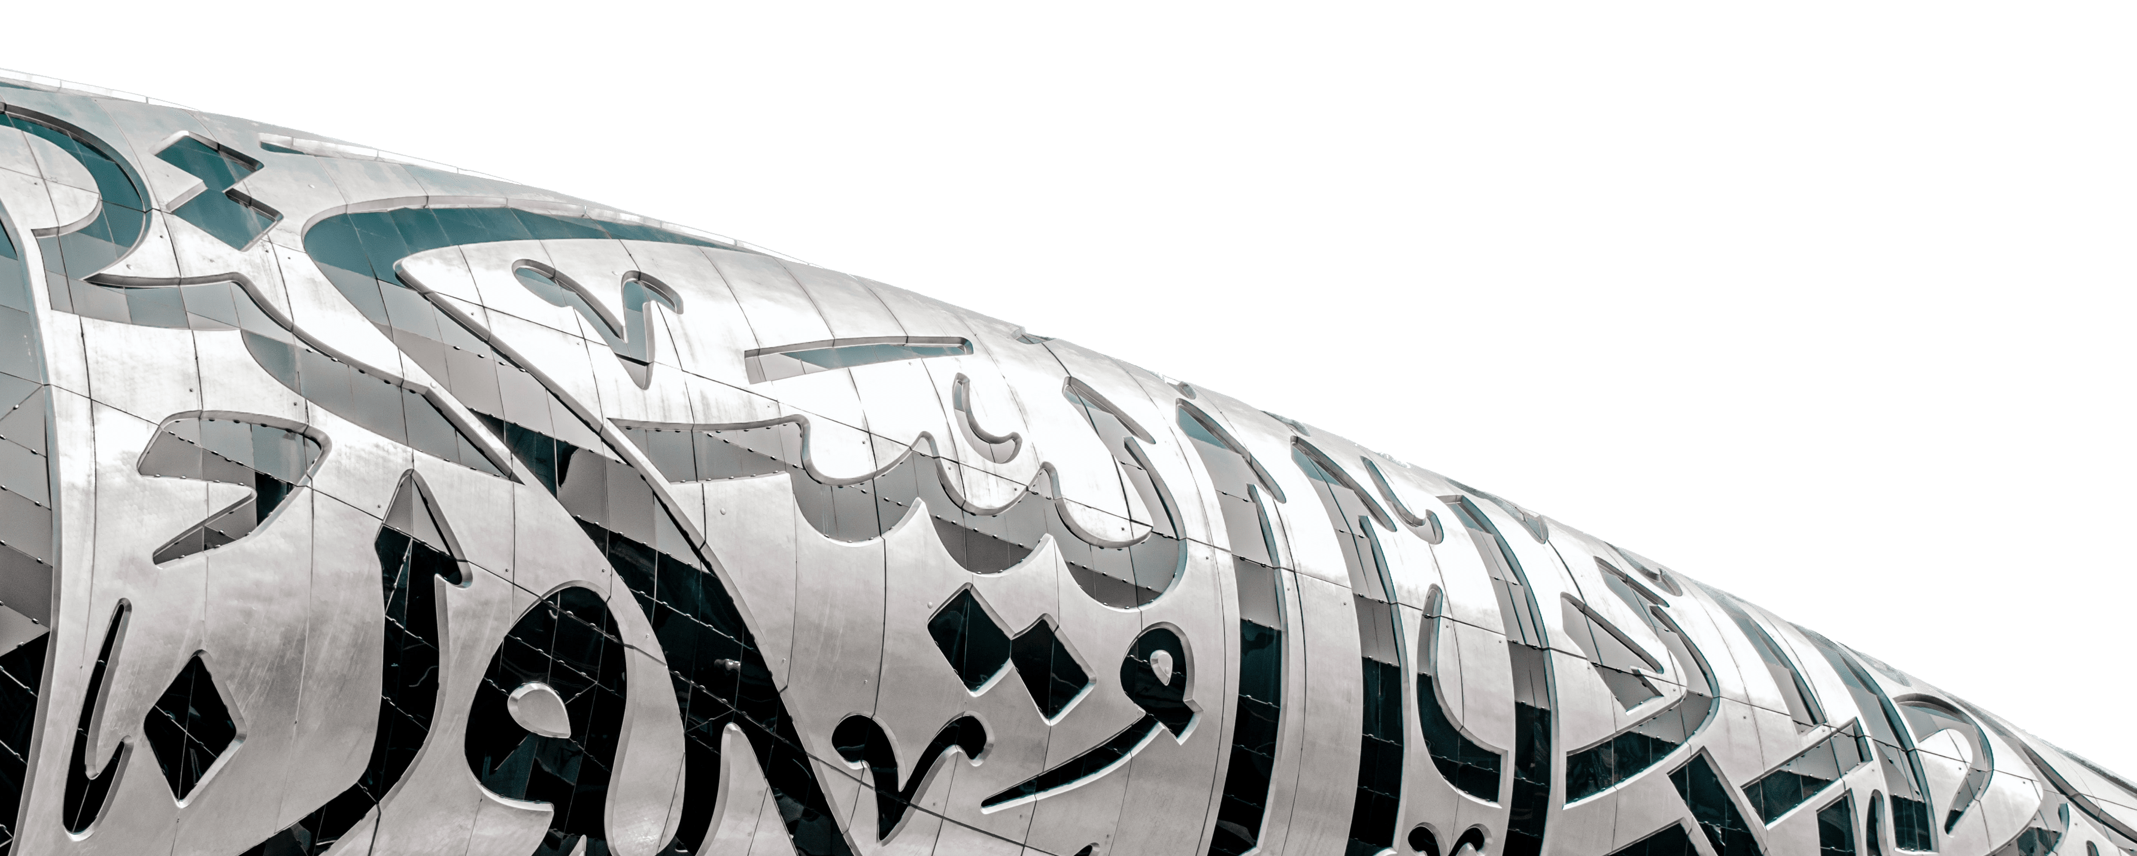
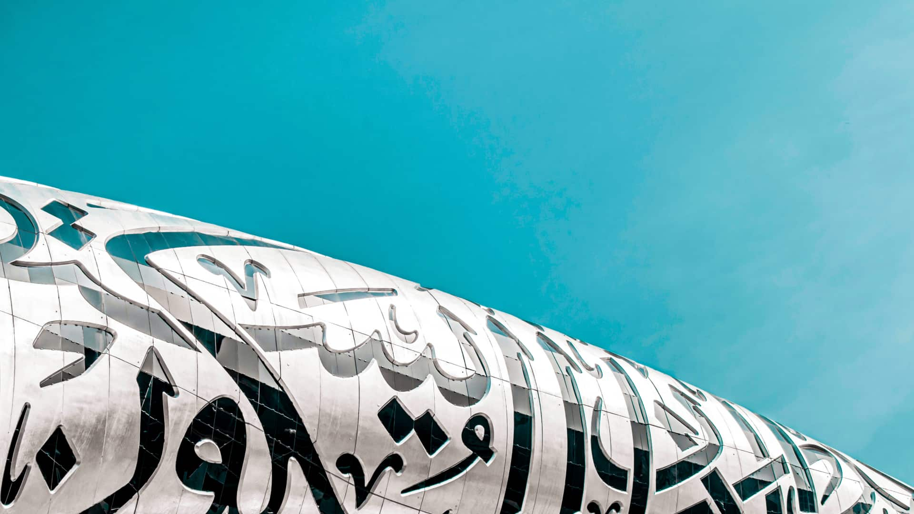
KHALIFA
WORLD’S TALLEST BUILDING
MUSEUM OF THE
BURJ
FUTURE
SAFARI
CAMEL: RIDING | DUNE BASHING | HENNA PAINTING SUNSET VIEWS | SHISHA | BELLY DANCING SHOW

Slide 8
SAFARI
CAMEL: RIDING | DUNE BASHING | HENNA PAINTING SUNSET VIEWS | SHISHA | BELLY DANCING SHOW
MUSEUM OF THE
FUTURE

